Slide 1
Selenium 4 New Features

Slide 2
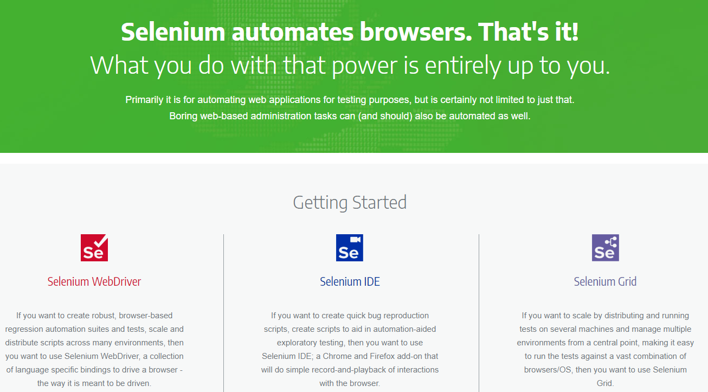
Selenium 4 Components
Selenium WebDriver
Selenium IDE
Selenium Grid

Slide 3
Selenium 4 New Features Demo
W3C WebDriver Protocol
Relative Locators
New Window/New Tab
getRect (location & size)
WebElement Screenshot
Chrome DevTools Protocol

Slide 4
Selenium
WebDriver

Slide 5
Selenium
IDE

Slide 6
Selenium IDE
Backup Element Selectors
Control Flows
Command Line Runner
Reuse A Test Case
Continuous Integration
Debugging

Slide 7
Selenium
Grid

Slide 8
Selenium Grid
New Architecture
Modern
Observability

Slide 9
Selenium 4 New Features Demo
W3C WebDriver Protocol
Relative Locators
New Window/New Tab
getRect (location & size)
WebElement Screenshot
Chrome DevTools Protocol

Slide 10
Components

Slide 11





Selenium Architecture
Selenium Client & WebDriver Language Bindings
Browser Drivers
Web Browsers
Java
JSON Wire Protocol
ChromeDriver
Chrome
JSON Wire Protocol Over HTTP
C#
GeckoDriver
Firefox
Python
SafariDriver
Safari
Ruby
OperaDriver
Opera
JavaScript
EdgeDriver
Edge
Client
Server

Slide 12
Selenium Architecture (Direct)
Selenium Client & WebDriver Language Bindings
Browser Drivers
Web Browsers
Java
ChromeDriver
Chrome
C#
GeckoDriver
Firefox
Python
SafariDriver
Safari
Ruby
EdgeDriver
Edge
JavaScript
Client
Server

Slide 13
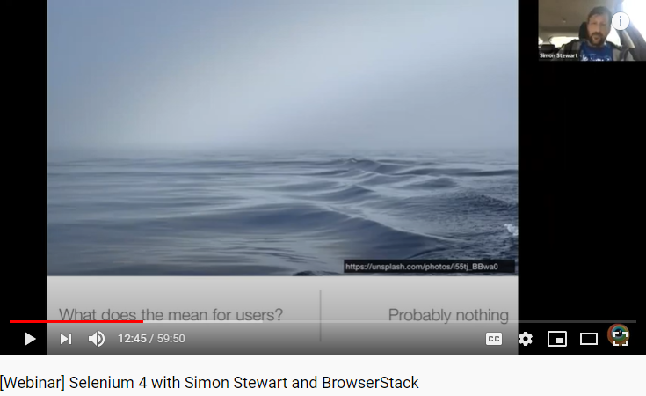

Slide 14
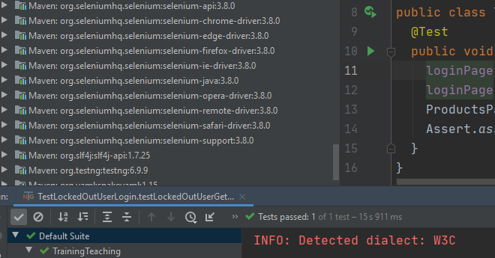
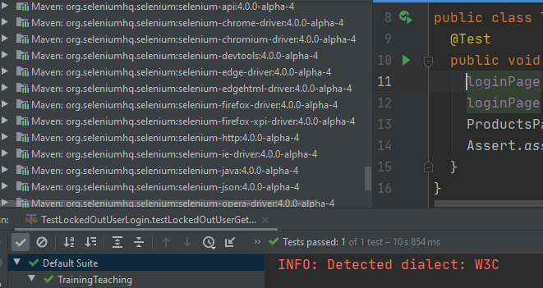
Selenium 3.8
Selenium 4

Slide 15
Selenium Architecture (Direct)
Selenium Client & WebDriver Language Bindings
Browser Drivers
Web Browsers
Java
ChromeDriver
Chrome
C#
GeckoDriver
Firefox
Python
SafariDriver
Safari
Ruby
EdgeDriver
Edge
JavaScript
Client
Server

Slide 16
Selenium Architecture (Remote)
Selenium Client & WebDriver Language Bindings
Browser Drivers
Web Browsers
Java
RemoteWebDriver
ChromeDriver
Chrome
C#
FirefoxDriver
Firefox
Python
SafariDriver
Safari
Ruby
Selenium Server
EdgeDriver
Edge
JavaScript

Slide 17
Advantages

Slide 18
Selenium Architecture (Direct)
Selenium Client & WebDriver Language Bindings
Browser Drivers
Web Browsers
Java
ChromeDriver
Chrome
C#
GeckoDriver
Firefox
Python
SafariDriver
Safari
Ruby
EdgeDriver
Edge
JavaScript
Client
Server

Slide 19
Mobile
Automation

Slide 20
Cloud
Platforms

Slide 21
Selenium 4 New Features Demo
W3C WebDriver Protocol
Relative Locators
New Window/New Tab
getRect (location & size)
WebElement Screenshot
Chrome DevTools Protocol

Slide 22
Demo

Slide 23
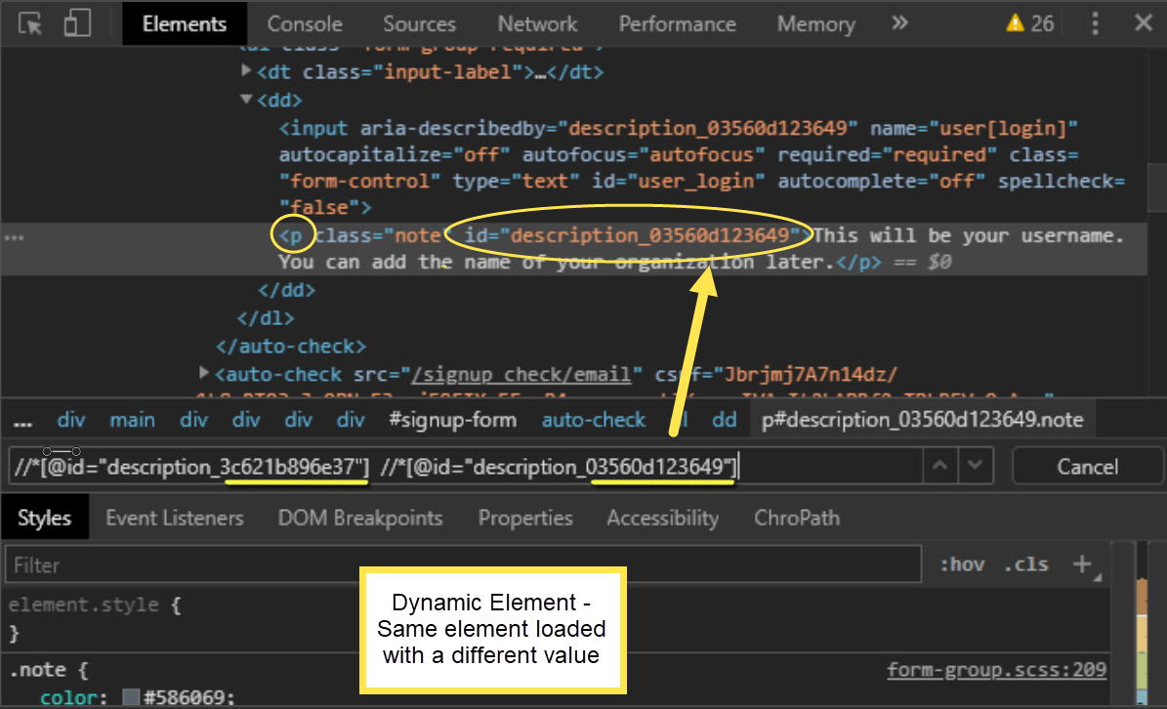

Slide 24
Use Multiple
Relative Locators

Slide 25
Find List of
WebElements

Slide 26
Selenium 4 New Features Demo
W3C WebDriver Protocol
Relative Locators
New Window/New Tab
getRect (location & size)
WebElement Screenshot
Chrome DevTools Protocol

Slide 27
New Window / New Tab Concept

Slide 28
New Window / New Tab Syntax
driver.switchTo().newWindow(WindowType.WINDOW).get(url); driver.switchTo().newWindow(WindowType.TAB).get(url);
Argument | Description
driver | Controls the browser
switchTo() | Sends commands to a window
newWindow() | Create a new browser window or tab then automatically switch focus
WindowType | An enum containing a list of constants (WINDOW and TAB)
WINDOW | A type hint parameter that creates a new window
TAB | A type hint parameter that creates a new tab
get(url) | Loads a new page in the browser

Slide 29
Demo

Slide 30
Open, Switch, & Work

Slide 31
Open, Switch, Work Then Switch Back To Parent
Open & Switch To New Tab
Work In The New Tab
Switch Back To The Parent Tab

Slide 32
Minimize Window Demo

Slide 33
Set Position & Robot Class

Slide 34
Selenium 4 New Features Demo
W3C WebDriver Protocol
Relative Locators
New Window/New Tab
getRect (location & size)
WebElement Screenshot
Chrome DevTools Protocol

Slide 35

Position
y
x
Dimension
height
width

Slide 36
Selenium 3
getLocation()
getSize()
x
y
width
height
Selenium 4
getRect()
x
x
width
height

Slide 37
Demo getRect

Slide 38
Compare Location & Size

Slide 39
Selenium 4 New Features Demo
W3C WebDriver Protocol
Relative Locators
New Window/New Tab
getRect (location & size)
WebElement Screenshot
Chrome DevTools Protocol

Slide 40
Take Screenshot
Take Screenshot of a WebElement
Take Screenshot of a Page Section

Slide 41
WebElement Screenshot

Slide 42
Section Screenshot

Slide 43
Full Page Screenshot

Slide 44
Selenium 4 New Features Demo
W3C WebDriver Protocol
Relative Locators
New Window/New Tab
getRect (location & size)
WebElement Screenshot
Chrome DevTools Protocol

Slide 45
Chrome DevTools Protocol
View Console Logs
Mock Geolocation
Enable Network

Slide 46
View Console Logs

Slide 47
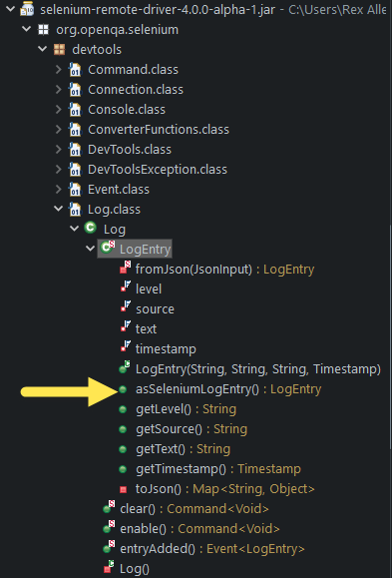
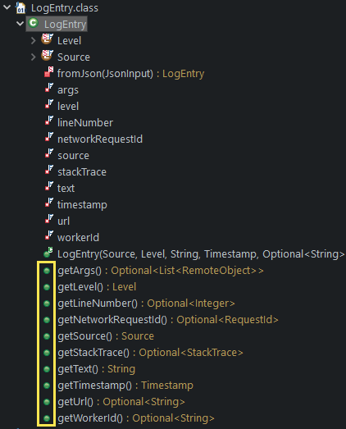
Selenium 4 LogEntry Class
Alpha 1
Alpha 6

Slide 48
Mock Geolocation

Slide 49
Enable Network

Slide 50
Untrusted Website

